Slide 1
Kanban vs. Scrum
By Joel Robinson March 2012 joelhrobinson@msn.com
Searches to use:
Kanban 101 Limited Work In Progress
Kanban Scrum Free Kanban eBook
Kanban vs. Scrum Agile wimps
www.kanban101.com
http://www.limitedwipsociety.org
http://www.crisp.se/henrik.kniberg/Kanban-vs-Scrum.pdf
http://www.infoq.com/minibooks/kanban-scrum-minibook

Slide 2
Why does Test lag Development?
Development
Testing
Coding starts early and continues during testing
Developers may or may not do build testing, installation, or support
Developers pull new projects, get reassigned
Bug fixes handed to QA for deployment and installation
Test driven development is rare, QA waits for code
QA does build testing, deployment, installation, regression, and support
QA may be finishing a feature from last iteration
After hand-off developer support diminishes

Slide 3
Why limit the work in progress?
Reduces cycle time per task
Insures WIP is highest priority task
Reduces queues between teams
Encourages teams to “swarm”
Highlights need to reallocate resources
Reduces multi-tasking by team members
Reduces lead times and increases quality
Increases quality by addressing issues early
David Joyce on “What happens when blocks occur in a limited workflow”

Slide 4
Kanban One minute History
Kanban is Japanese, originally meant a visual card or signboard or billboard.
Kanban originated at Toyota to track # cars on floor
Cars/components represented by a card stuck on a bulletin board
New cards posted as components arrive / created
Old cards removed as components leave / combined
Goal: keep # cars/components in the plant at a minimum
Goal: keep cars/components moving, no bottlenecks
Goal: know where each car/component is at any moment

Slide 5
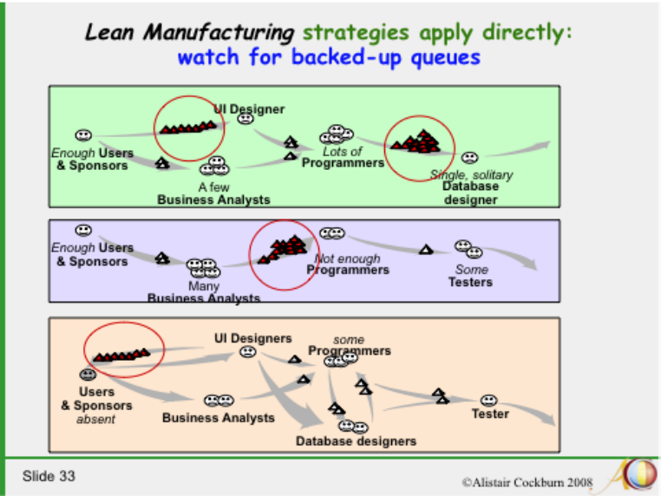
“Agile is for Wimps” Cockburn’s Software Engineering in the 21st Century: http://alistair.cockburn.us/Software+engineering+in+the+21st+century.ppt

Slide 6
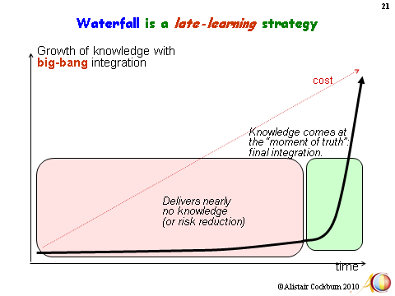
“Agile is for Wimps” Cockburn’s Software Engineering in the 21st Century: http://alistair.cockburn.us/Software+engineering+in+the+21st+century.ppt

Slide 7
http://www.kanban101.com/what-is-kanban/
Kanban is a lean agile system that can be used to enhance any software development lifecycle including Scrum, XP, or Waterfall. It is NOT EXCLUSIVE TO AGILE.
Its goal is the efficient delivery of finished features
Kanban promotes the lean concept of flow
  to continuously and predictably deliver value.
The work and the workflow are made visible to show activities, issues, and backups.
Kanban seeks to limit work in progress

Slide 8
Kanban is subset of Agile
Cycles are calendar based Sprints (~2 weeks)
Projects are estimated and bid on prior to start
Teams accept multiple features/tasks per iteration
Features are worked on start to finish
Only bug free & deployed features leave sprint
Test/integration may be part of each team
Test/integration often bottleneck at end of Sprint
Swarms-- a team drops what they are doing to help resolve a bottleneck

Slide 9
Agile vs. Kanban
Agile features:
Splits calendar into fixed cycles or sprints
Teams organized for sprint duration
Initiates Features based on Sprints
Limits Work in Progress to sprint
Optimizes # Features per sprint
Releases at end of sprint
Each team has input / output queues
Kanban features:
Organized workflow as an assembly line. No calendar rules
Team organized for process flow
Initiates Features based on priority
Limits Work in Progress Totally
Optimizes cycle time per Feature
Releases continually
Few team queues

Slide 10
Four Kanban Work-Flow Stations
Business Analysis & Product Owners Team
  Create specifications and acceptance criteria.
  Specifies priority and estimates weight
Development Engineering Team
  Creates coded features (and bugs)
  Fixes bugs
Test/QA Engineering Team
  Creates and runs tests
  Creates bug reports and verifies bugs
Deploy Integration Team
  Integrates systems, deploys and releases code to customer
  Creates bug reports and verifies bugs

Slide 11
Kanban vs. Agile Game Rules
Business & analyst Team | Development Team
Create new task sheets -- Create Name & Description -- Assign Priority and weight for each team: Dev., QA, & Deploy Adjust priority anytime Pass new tasks ➔ Backlog queue Wave/shout when task deployed | Take highest priority task/inspect Roll dice # times to decrement If roll “1” write “Dev. bug” in box If roll dice “6” restart decrementing When decremented fully: Write “Code Complete” on tasks Write ‘Fixed’ on each bug Pass completed sheets ➔QA team
QA Test Team | Deploy Team
Take highest priority task/inspect Roll dice # times to decrement If roll “1” write “QA bug” in box If roll “6” restart decrementing When decremented fully: Write “Tested” on task/bug Pass new bugs ➔Development Pass verified sheets ➔Deploy | Take highest priority task/inspect Roll dice # times to decrement If roll “1” write “Deploy bug” in box If roll “6” restart decrementing When decremented fully: Write “Deployed” on task/bug Pass new bugs ➔Development Pass deployed sheets ➔Biz team

Slide 12
Rules for Game Master
“Seed” the game to get things going
Remove the Agile queues after first round
Encourage the lyric / limerick speaking/singing…Have Fun
Hold stand-up Scrum meetings
Hold retrospective meetings
Keep tasks flowing and dice rolling
Identify bottlenecks and call swarms
If doing Agile, allow queues
If doing Kanban, do not allow queues

Slide 13
Retrospective Sheet
Call for retrospective
Total # tasks completed
Poll the team members for ideas to improve
  What went well
  What did not go well
  What needs improvement
Modify the game or team members and repeat

